Slide 1
STUDENT NAME – HariNivas R REGISTER NO – 711721243031 DEPARTMENT – B.Tech Artificial Intelligence and Data Science
Rice Classification using CNN
3/21/2024 Annual Review

Slide 2
PROJECT TITLE : Rice Classification using CNN
3/21/2024 Annual Review

Slide 3


AGENDA
Problem Statement
Project Overview
End Users
Our solution and Proposition
Key Features
Modelling Approach
Results and Evaluation
Conclusion
3/21/2024 Annual Review

Slide 4

PROBLEM STATEMENT
Mistakes during manual sorting processes lead to fluctuations in rice quality, which have a detrimental impact on producers, distributors, and consumers alike.
The inadequacy of classification methods results in economic losses by undervaluing superior-quality rice and discarding lower-grade varieties, thereby affecting the financial viability throughout the supply chain.
Accurate rice classification plays a pivotal role in waste reduction and sustainability promotion. Through efficient utilization of rice across various grades, it fosters environmental stewardship and optimizes resource usage
3/21/2024 Annual Review

Slide 5
PROJECT OVERVIEW
The goal of the Rice Classification System is to develop an automated platform that is both highly efficient and precise, capable of categorizing rice based on a comprehensive range of quality factors.
This system fulfills the need for standardized quality control, aligning with market expectations, and ensuring the economic sustainability of the rice industry.
Detecting and eliminating contaminants and impurities from rice plays a crucial role in safeguarding consumer health by minimizing potential health risks and hazards.
Improving efficiency in rice processing accelerates product delivery to consumers, guaranteeing prompt access to high-quality products.
3/21/2024 Annual Review

Slide 6

WHO ARE THE END USERS?
Agricultural researchers and scientists
Farmers and agricultural workers
Food processing companies
Agricultural technology companies
Government agencies and policymakers
3/21/2024 Annual Review

Slide 7

YOUR SOLUTION AND ITS VALUE PROPOSITION
Our proposed solution includes deploying a Convolutional Neural Network (CNN) architecture that will be trained on a dataset consisting of labeled images representing different rice varieties.
Automated image analysis ensures precise classification and quality assessment of rice varieties, enhancing agricultural efficiency and accuracy.
Automating image analysis not only enhances agricultural practices but also drives advancements in computer vision technology, benefiting multiple sectors and fostering innovation.
3/21/2024 Annual Review

Slide 8

THE WOW IN YOUR SOLUTION
Automating image analysis revolutionizes rice classification methods, bringing efficiency and accuracy to agricultural processes.
Instantaneous and accurate assessment of rice variety quality with precision and speed is achieved through automated image analysis techniques.
Automated image analysis empowers stakeholders, from farmers to policymakers, by providing timely and accurate insights, leading to informed decision-making in agriculture.
Applying technology in agriculture boosts food security and sustainability, enhancing efficiency and resource management.
3/21/2024 Annual Review
8

Slide 9
MODELLING
Convolutional Neural Networks (CNNs) for Rice Classification:
Convolutional Neural Networks (CNNs) are highly effective for rice classification tasks due to their autonomous feature learning and hierarchical feature extraction capabilities from images.
This enables accurate categorization of rice types based on visual cues, enhancing classification accuracy. By leveraging CNNs, rice classification processes can be automated, leading to streamlined operations and consistent, reliable results.
Data Preprocessing for Rice Classification:
Load rice grain images from the dataset while ensuring each image is paired with its corresponding rice type label, facilitating supervised learning for accurate classification tasks
Normalize the pixel intensities of the images to a scale between 0 and 1, promoting uniformity across data samples and assisting training algorithms in achieving better convergence and performance.
Training Process for Rice Classification:
Train the CNN using SGD or Adam to minimize loss, then evaluate its performance on the validation set for generalization and overfitting detection.
3/21/2024 Annual Review
9

Slide 10
MODELLING
Fine-Tuning for Rice Classification:
Freeze initial layers to preserve learned features, unfreeze top layers for adaptation to rice features, then fine-tune with lower learning rate to maintain pre-learned features..
Model Evaluation for Rice Classification:
Compute accuracy on test set for overall performance, calculate precision, recall, and F1-score for individual rice types, and generate a confusion matrix for detailed performance visualization.
Furthermore, generating a confusion matrix visually represents the model's predictions, aiding in understanding true positive, false positive, true negative, and false negative predictions for each class, providing a comprehensive assessment of its performance across different categories.
3/21/2024 Annual Review
10

Slide 11
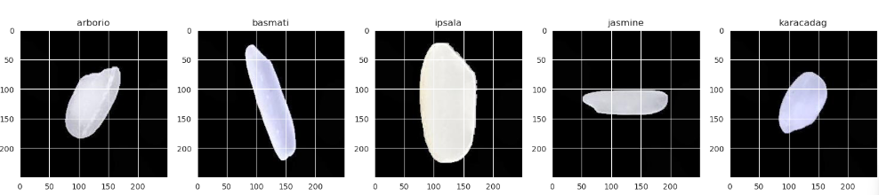
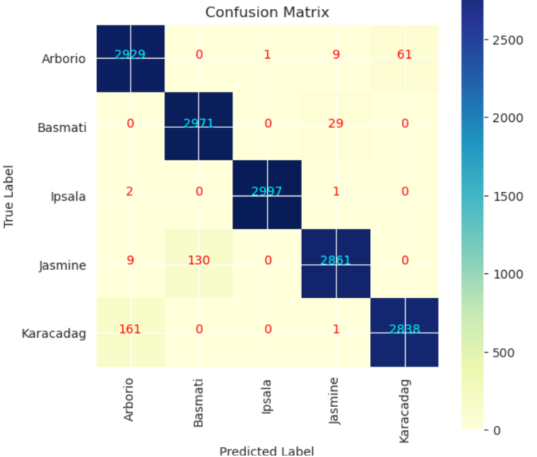
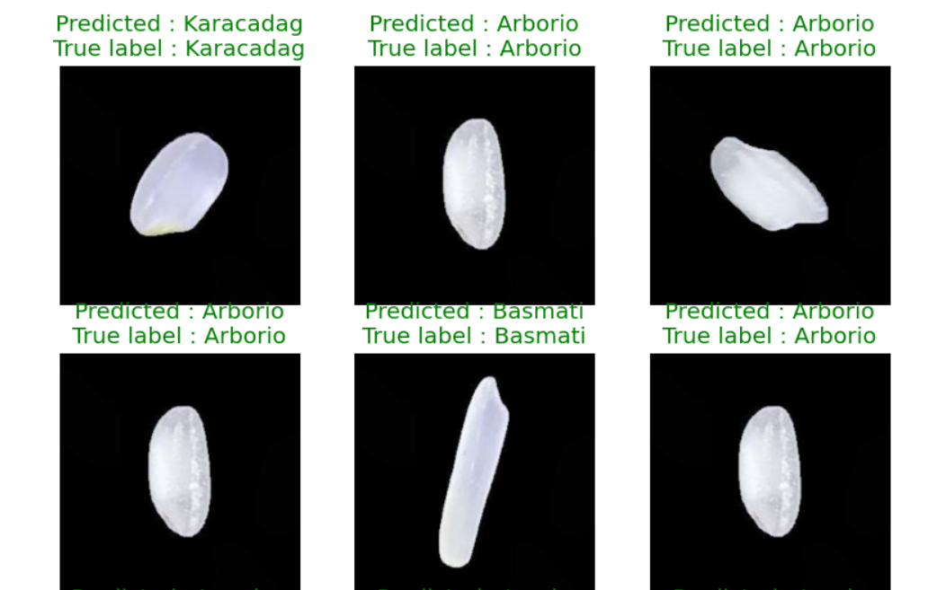
RESULTS
3/21/2024 Annual Review
11

